Slide 1
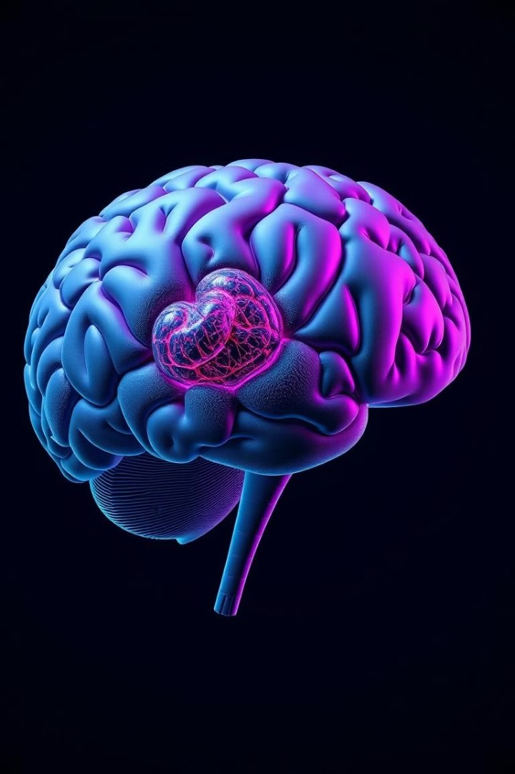

Brain Tumor Detection with Convolutional
Neural Networks
This presentation outlines a project to develop a convolutional neural network (CNN) for accurate brain tumor detection and classification.
Under supervision :
Dr: Samar El_Bedwehy

Slide 2

Made by :
Aml EL Banna
Leila Hamada
Mostafa Hesham
Mahmoud Samy
Ziad Abdel Fattah
Mazen Fayed

Slide 3

Agenda
Project overview Problem statement Methodology
Data Collection and Preprocessing Model Development
Confusion Matrix
Deployment

Slide 4
Project overview
The project aims to detect brain tumors in grayscale MRI images, with the objective of accurately identifying the presence of a tumor. Deep learning, specifically using convolutional neural networks (CNN), was applied to analyze the images. The model was trained and tested to achieve high accuracy in diagnosing brain tumors.

Slide 5
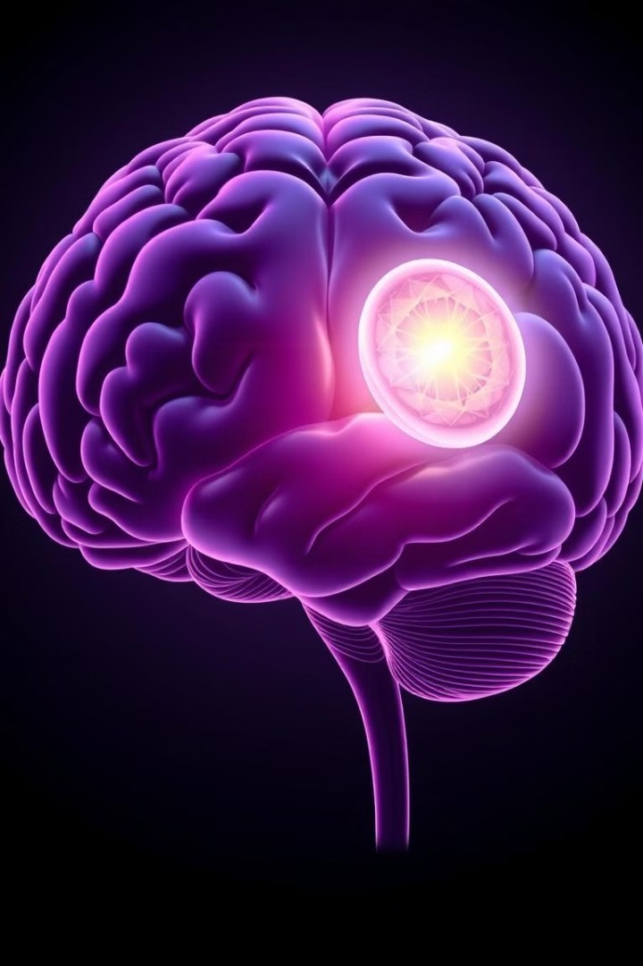
Problem Statement
The main challenge in diagnosing brain tumors is that interpreting MRI scans can be prone to errors, even for experienced radiologists. Factors like image quality and tumor size can make it difficult to analyze the scans accurately, potentially leading to missed or incorrect diagnoses.
Solution
Develop a deep learning model that accurately detects brain tumors in various grayscale MRI images, ensuring reliable performance across different image qualities and patient anatomies.

Slide 6
Software used
Python: The programming language for developing the project.
Google Colab: The cloud-based platform for coding and running the machine learning model.
OpenCV: For image processing tasks, such as reading and resizing images.
PIL (Pillow): For image manipulation and conversion.
NumPy: For handling numerical operations and array manipulations. TensorFlow/Keras: For building and training the Convolutional Neural Network (CNN). Matplotlib: For visualizing the training process, including accuracy and loss graphs.
Seaborn: For creating informative and attractive statistical graphics, such as visualizing the confusion matrix.

Slide 7
Methodology
1
Data Collection
The dataset used for this project is the Brain Tumor Detection MRI dataset, sourced from Kaggle.
Link : Brain_Tumor_Detection_MRI (kaggle.com)
Preprocessing
Preparing the data for model training by resizing to 64×64 , and Labeling the Data 1 for tumor , 0 for
normal.
Model Development
Implementing a CNN architecture for brain tumor detection, incorporating three convolutional layers, pooling layers, a fully connected dense layer, and an output dense layer with dropout for improved accuracy.
2
3
Training
The model was trained on 64x64 grayscale MRI images using a batch size of 16 for 10 epochs. After training, the model was saved for future use.
Evaluation
Assessing the model's performance using appropriate metrics like accuracy, confusion matrix on a separate test
dataset.
4
5

Slide 8
Data Collection and Preprocessing
The project utilizes publicly available datasets of brain MRI scans annotated with tumor information.
Preprocessing Steps
Visualize dataset images
Put the labeling for the folders
Image data processing (Resizing images to 64×64,and Normalization)
applying one-hot encoding
Dataset Acquisition
The used dataset has three folder:
yes(for tumor) -1500 images- no(for normal) -1500 images- pred(for testing) -60 images-

Slide 9
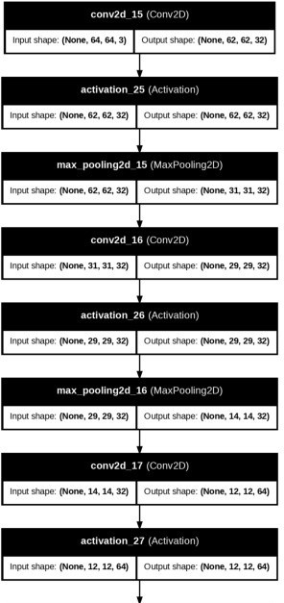
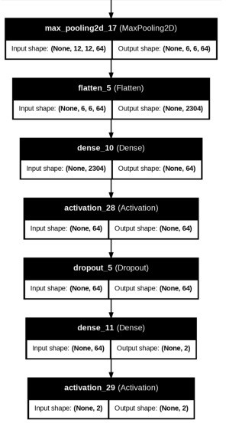
Model Development
In our brain tumor detection project using MRI scans, we use Convolutional Neural Networks (CNNs), which are specialized algorithms for analyzing images, to classify them as normal or tumor. We start by gathering a balanced dataset and preprocessing the images to ensure consistency. After training the CNN on this data, we evaluate its performance on new images to help with early diagnosis and medical intervention..

Slide 10
Evaluation Metrics
Metric
Description
Accuracy
Training Accuracy: 1.00 %
Test Accuracy: 98 % Validation Accuracy: 98 %
confusion matrix
In our project, a confusion matrix helps evaluate the brain tumor detection model's performance by showing the counts of true positives, true negatives, false positives, and false negatives.

Slide 11
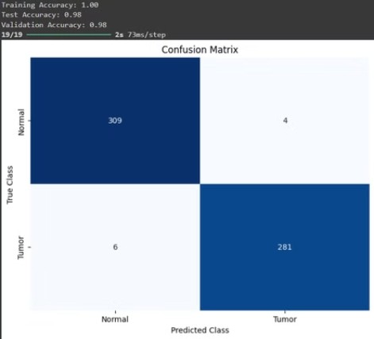
Confusion Matrix

Slide 12
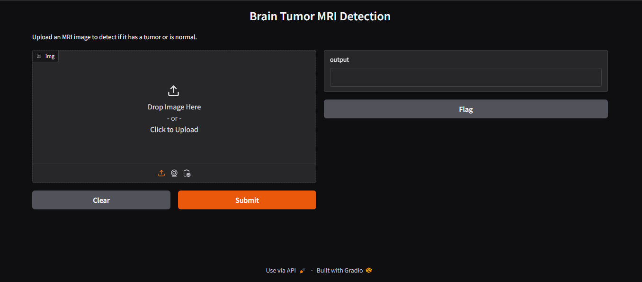
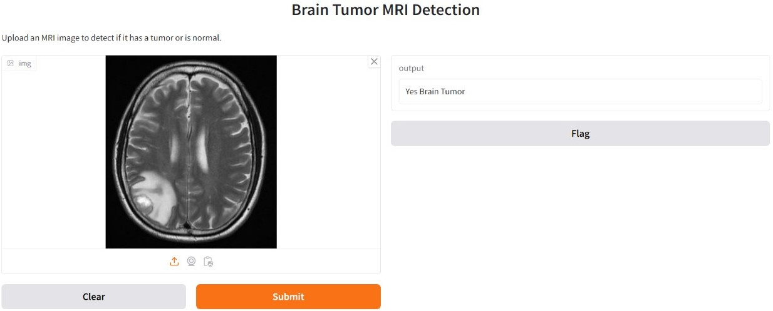
Deployment

Slide 13
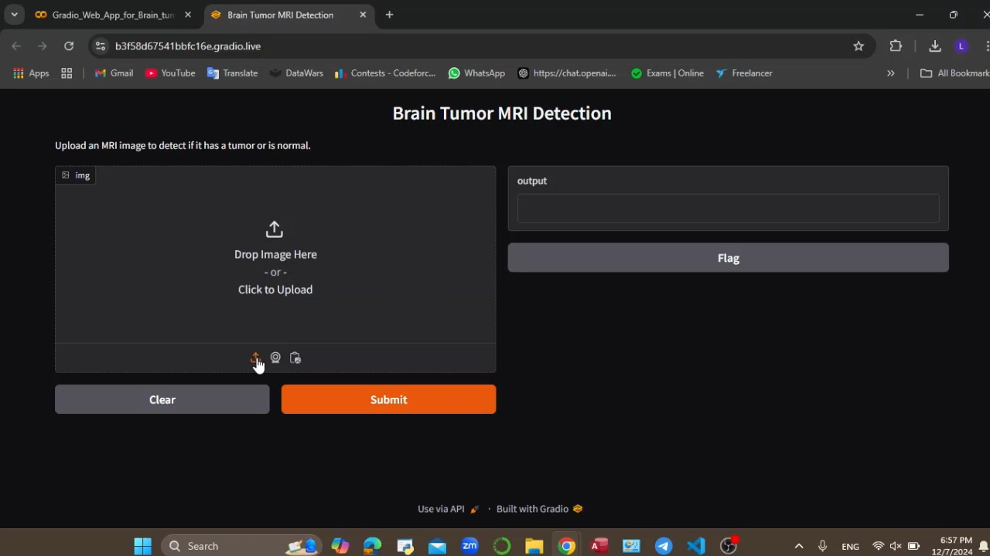

Slide 14
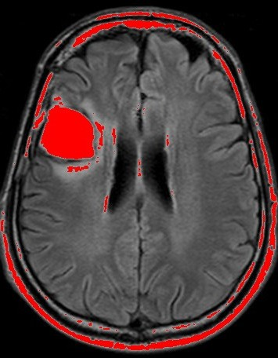
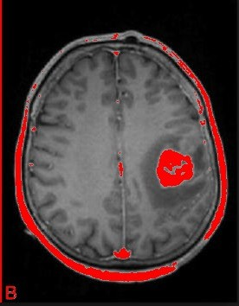
Future
Directions
segmentation

Slide 15
Thank You

